Slide 1
AI Powered Loan Application
11/10/2017
Team Crystal Ball
Melinda Xiao-Devins, Vincent Liu, Yiyang Shen, Tian Chen, Zhongliu Li, Suman Nokhwal

Slide 2
AI Powered Loan Application
Goal:
Implement machine learning and deep learning models, predict loan approval probability
Build an end-to-end system -> show case product with AI inside

Slide 3
Achieved: Implement an end-to-end system
Implement Machine Learning models:
Random Forest Classifier
K Nearest Neighbor
Logistic Regression
Naive Bayes
Support Vector Machine (SVC and Linear SVC)
Implement Neural Network Classifier (trained with GPU)
Use Flask framework to host real time prediction API using trained ML/DL models (essentially an AI platform).
Integrate with Encompass EBS API
Integrate Consumer Connect Loan App UI with Flask backend

Slide 4
The machine learning framework
f ( x ) = y
Training: given a set of {(x₁,y₁), …, (x_{N}, y_{N})}, discover f
Testing: apply f to a never seen test x, diff f(x) with real y
Prediction: new x , use f to predict y
prediction function
loan applications
output ( approve or not)
Slide credit: L. Lazebnik

Slide 5
Data Pre-processing
HMDA public mortgage loan data for New York 2015.
Source Url: https://www.consumerfinance.gov/data-research/hmda/explore
Inspect the data
Drop redundant columns, drop missing data rows
Scale continuous value columns
One hot encode categorical features (columns)

Slide 6
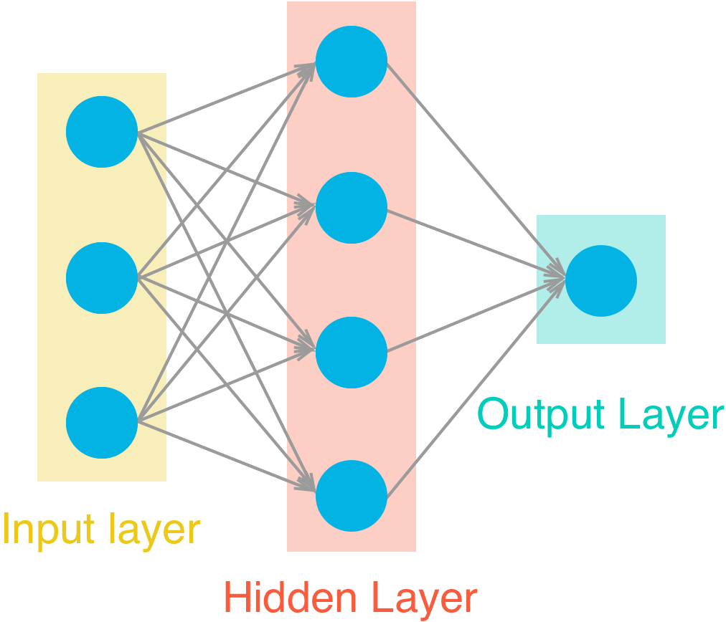
DL Neural Network Topology: 60 -> 32 ->16 -> 8 -> 1

Slide 7
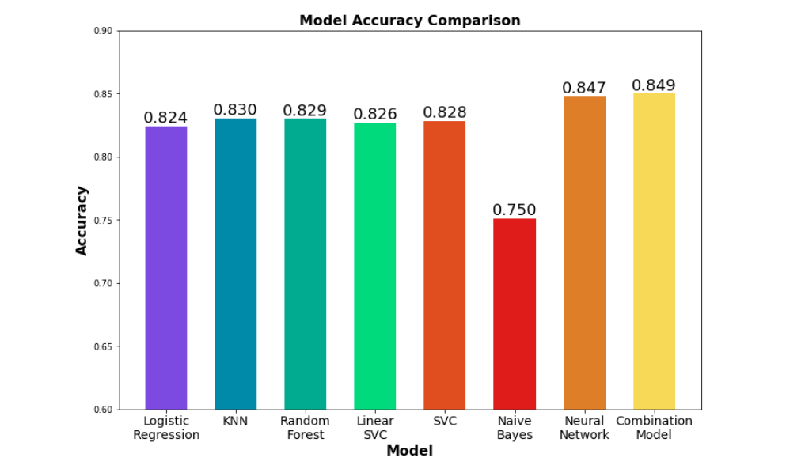
ML/DL Model Comparison - Accuracy

Slide 8
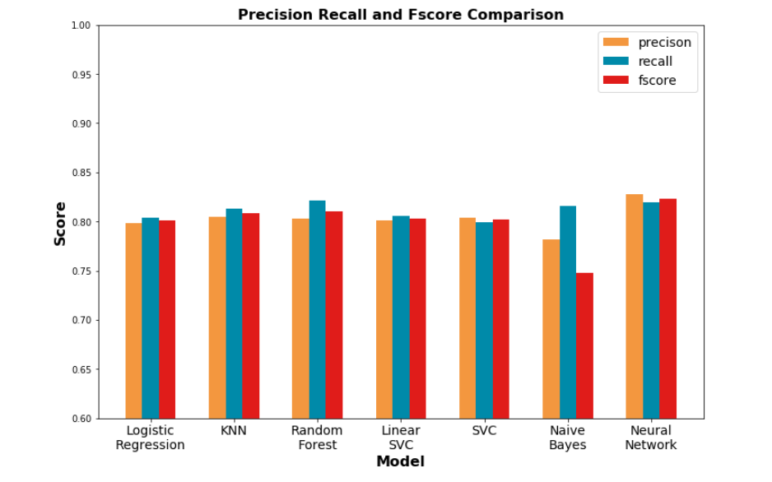
ML/DL Model Comparison - Precision and Recall

Slide 9
LoanApp UI
5. Get Prediction
Get Loan
8. Give Prediction Rate
4. Loan Info
Flask Backend
ML Prediction Model
EBS
2. Get Loan by ID
6. Call Model.Predict()
3. Loan Info
7. Calculate Loan Approval Rate

Slide 10
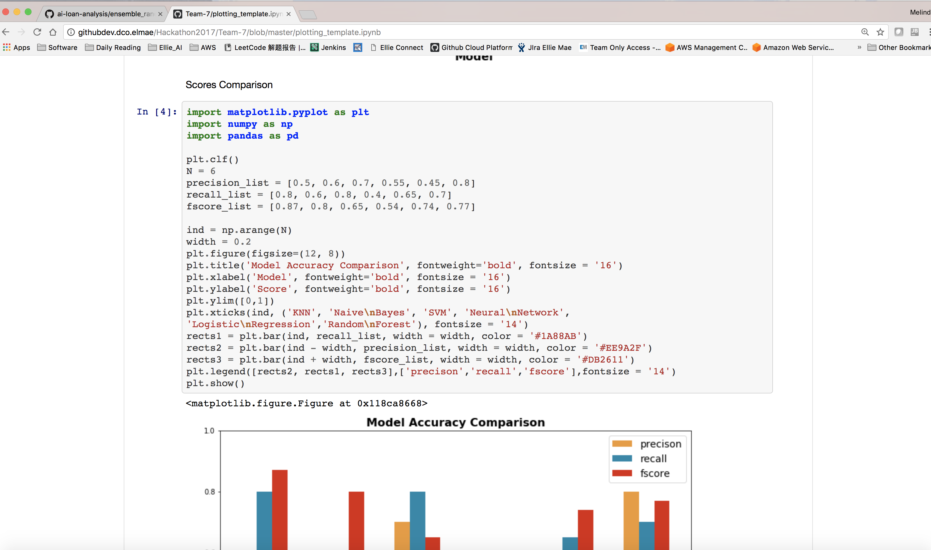
Team 7 source code – Jupyter notebook (source code, comments, execution results, graph etc)

Slide 11
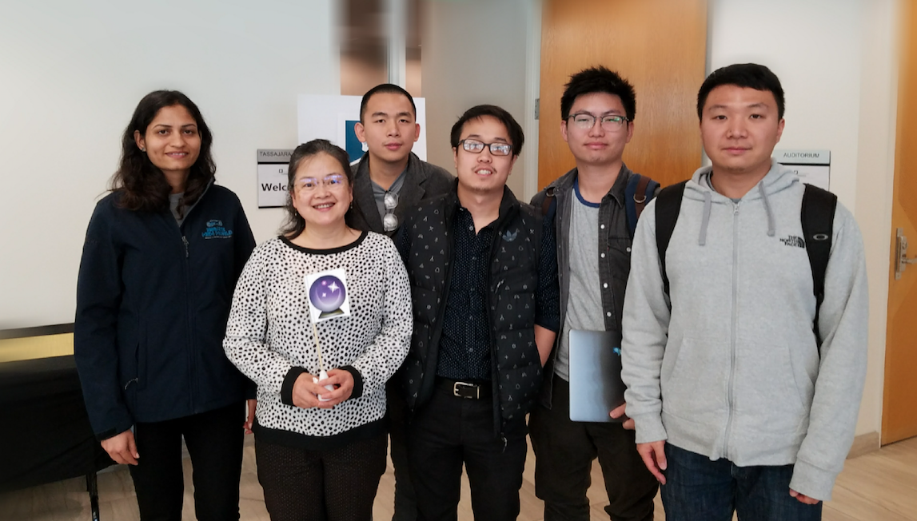
Suman Nokhwal, Melinda Xiao-Devins, Zhongliu Li, Vincent Liu, Tian Chen, Yiyang Shen

